Slide 1
Can We Predict Happiness?
Happiness and its contributing factors
By Group 2: Assistant Cisse, Diana Borkar, Merelynn (Lynn) Okang & Gloria Yahouedeou

Slide 2




Why this topic?
The team selected this topic because we were trying to find what defined happiness in countries around the world.
We were also looking for a good and clean dataset with solid features and information to train a machine on. Maybe we could predict a country’s happiness based on certain factors, such life expectancy, or freedom?
Let’s further explore!

Slide 3
Sources
In order to address our main question we used various data sets.
The main dataset being used is a collection of data from the World Happiness Report. It is a landmark survey of the state of global happiness. The data set has a collection of indicators on more than 140 countries around the world including happiness rank, happiness score on a scale of 0 to 10, standard error, and more… The data set includes reports from 2015 to 2016, which we decided to focus on for our machine learning model.
We will also be using the World Bank Life Expectancy data set and the Human Freedom Index, to compare against (for the years that align with our main data set) using the same years as indicators.

Slide 4
Our hypothesis:
We want to find which factors influences happiness within a country and we would also like to found. out how to predict the happiness scores, IF it is at all possible to do so.

Slide 5
Data exploration phase
Description of the data exploration phase of the project
Column representation and their application to hypothesis at first glance
Defining data that is being collected

Slide 6
Data Cleanup

Slide 7
Overview
Columns needed /process
Bhutan
PgAdmin

Slide 8
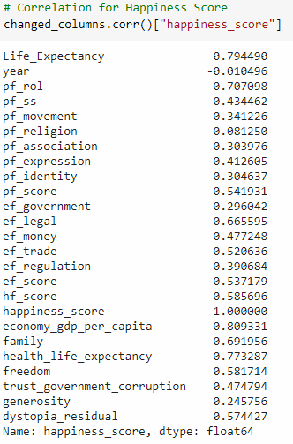
Happiness score = think of a ladder with the best possible life for them being a 10 and the worst possible life being a 0

Slide 9
Machine Learning Model

Slide 10
Data was split into 2015 and 2016 data sets
38-48% accuracy rate
Different combination of columns. By using less columns and only the one that used the highest level of correlation would be used to train the machine and they had the best impact on the accuracy of the machine learning model

Slide 11
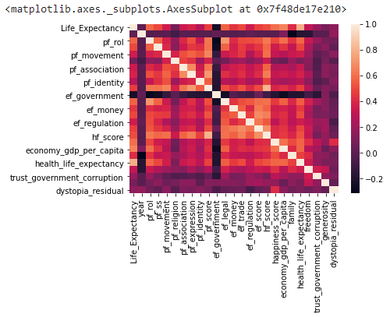

Slide 12
Visuals and Dashboard:
Tableau

Slide 13
Linear Regression
X column
Y what to predict

Slide 14

Worksheets
Top 10 happiest countries
Top 10 least happiest countries
Top 10 countries with high freedom score
~15
Top 10 countries with long life expectancy
Top 10 countries with shorter life expectancy
Top 10 countries with low freedom score
Heatmap mapping correlation between all column
Correlation Happiness, life and freedom
Linear regression machine learning model

Slide 16
Dashboard
Happiness around the world
(Heat map)
Bubble size and color coding
Top 10 countries with high freedom score
2
Where are people most happy
Factors contributing to happiness
Notes:
https://public.tableau.com/profile/gwennisme#!/vizhome/WorldHappinessIndex_3/Dashboard
https://public.tableau.com/profile/brian.moore7221#!/vizhome/HappinessAroundtheWorld_15958968487800/Happiness

Slide 17
Stories
Top 10 happiest countries
Top 10 least happiest countries
Top 10 countries with high freedom score
1
Top 10 countries with long life expectancy
Top 10 countries with shorter life expectancy
Top 10 countries with low freedom score
Heatmap mapping correlation between all column
Happiness and freedom
Linear regression machine learning model

Slide 18
Summary Analysis

Slide 19
Tools
To create visuals regarding happiness scores in the world and gauge the effects of factors such as life expectancy, or freedom, we will:
Use Pandas (in Jupyter Notebook) to create clean CSV files to pull data from.
Use Tableau graph feature and a layer to present machine learning model results
Use plot lines visuals to shows the effect of each factors
We will also aim to create interactivity with our final dashboard i.e., Color map for world map

